Slide 1
Customer Churn Analysis Capestone Project Divyansh Kumar Gupta Mentor- Shruti Gode

Slide 2
Business Objective
A certain bank in North America wants to perform cusstomer churn analysis, as the credit card business of the bank is not performing well. Churn analysis will help the bank evaluate the customers who have stopped purchasing the credit card of the bank and figure out measures to reduce the bank's customer loss rate.

Slide 3

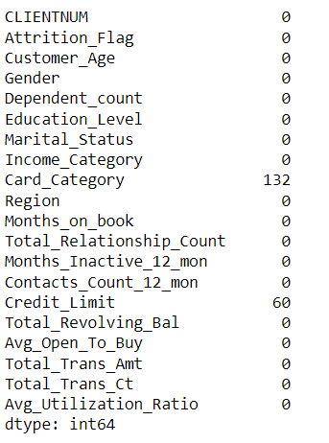
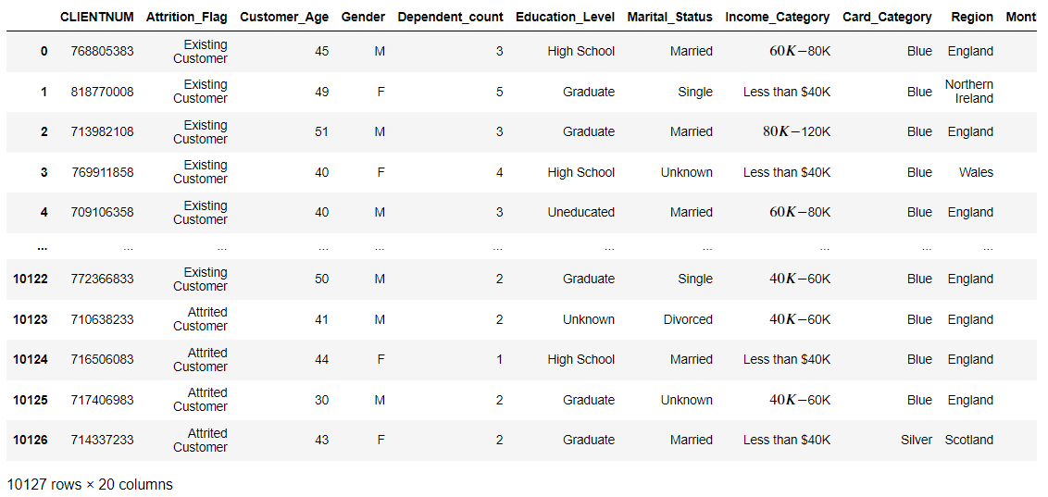
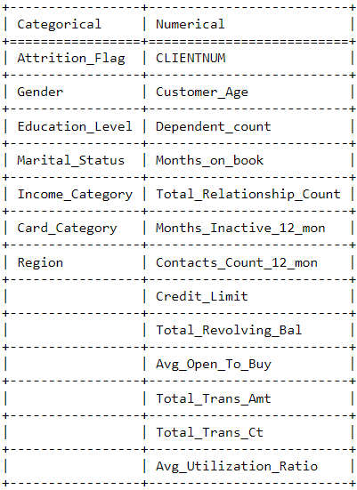
Dataset

Slide 4
Outlier Detection
Outliers are the distinct data present in a column which is extreme high or extreme low. In the customer churn analysis there are several numerical columns with outliers present in it. To analyse further these outliers from the relevant column has been detected.
There are 57 outliers present in customer age, 63 in dependent counts, 1008 in credit limit column and 896 in total transaction amount column.

Slide 5
Data Visualization

Slide 6
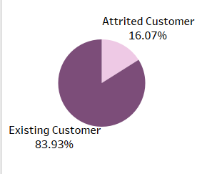
Total Percentage of Attrited and Existing Customers
Interpretation: The visual shows that approximately 16% of customers have already attrited and rest are the existing.

Slide 7
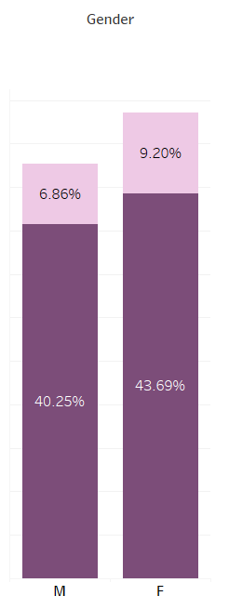
Gender Wise Percentage Of Attrited and Existing Customers
Interpretation: The visual shows that 43% of the existing customers are females and among them 9.20% have already attrited whereas 40% of the existing are male

Slide 8
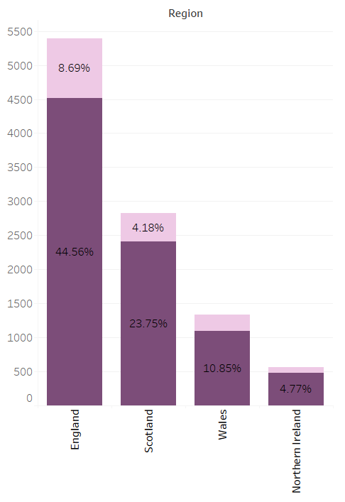
Region Wise Percentage Of Attrited and Existing Customers
Interpretation: The visual shows that approximately 45% of the existing customers are from England among them 8.6% have already attrited, 24% from Scotland and rest from Wales and Northern Ireland

Slide 9
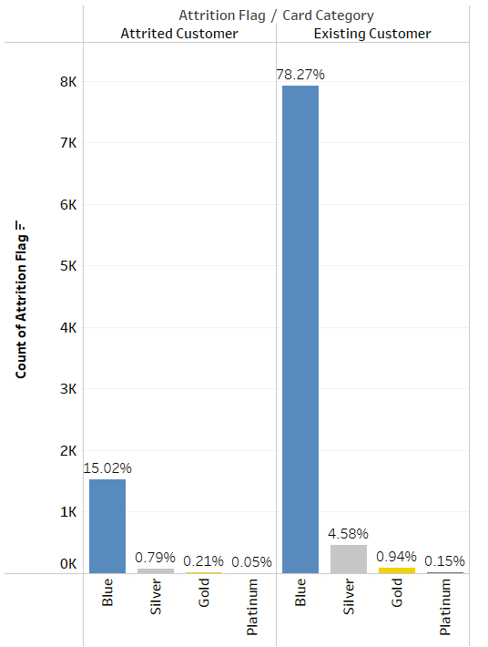
Percentage of Attrited and Existing Customers From Each Card Category
Interpretation: The visual shows that 15% of the attrited customers had blue card,0.79% silver, 0.21% gold and only 0.05% platinum.
78.27% of the existing customers are having blue card, 4.58% silver, 0.94% gold and only 0.15% platinum.

Slide 10
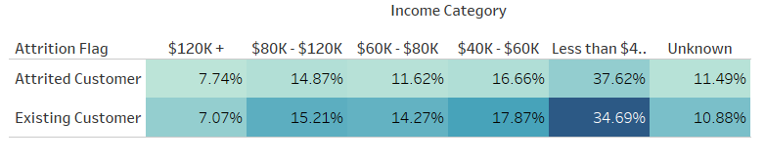
Percentage of Attrited and Existing Customers as per there income category
Interpretation: The visual shows that approximately 35% of the existing customers are having income less than 40K and 37% of the attrited customers had income less than 40K

Slide 11
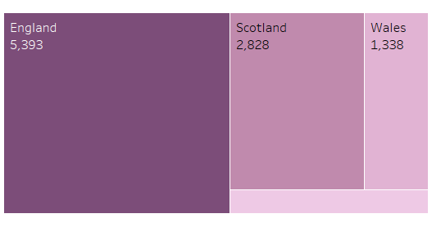
Region Wise Count Of Customers
Interpretation: The visual show that 5393 number of customers from England and 568 from Northers Ireland which is the lowest of all.

Slide 12
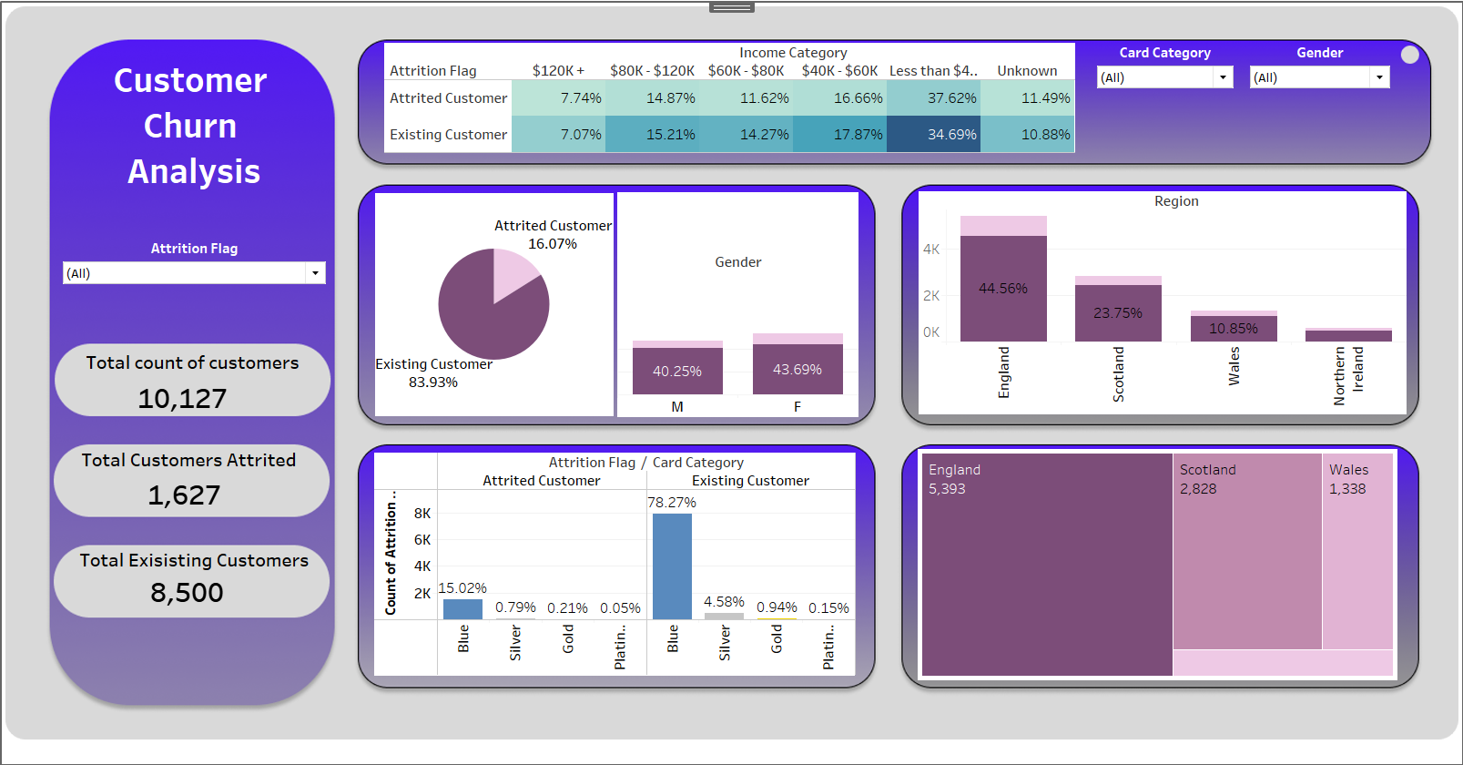

Slide 13
Conclusion
Keeping the business object in mind all the relevant columns have been considered in the analysis. By the analysis we can finally interpret that 16% of the total customers have already attrited and 84% are still connected with the bank. Regions like ‘Scotland’, ‘Wales’ and ‘Northern Ireland’ are need to be targeted more in order to increase the customers from such regions. The bank also needs to find the reason why the customers are not upgrading to the silver, gold and platinum cards. Customers with high income are an asset to the bank, attrition of such customers is a huge loss, the bank need to find the problem behind the attrition of customers with more than $50k income as there is only 7.07% of the customers with $120K income.
By considering these patterns the bank can focus more on these aspects to lower the attrition of the customers.

